Slide 1

MORTI
Multi Observation Reality Tool and Interface
UNL RED Teams 22-23

Slide 2
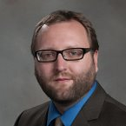
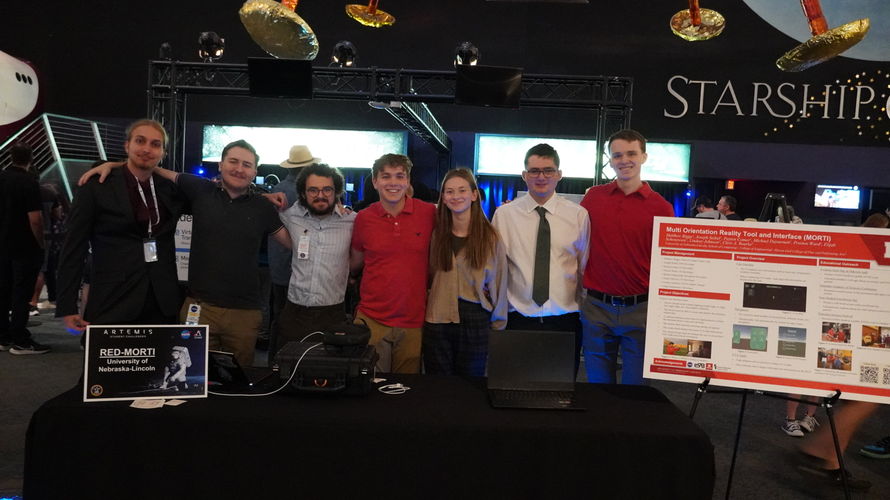
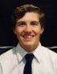

Advising Professor
Dr. Chris Bourke
Members from left to right: Elijah Schoneweis, Matthew Bigge, Joseph Seibel, Peyton Comer, Lindsey Johnson, Michael Dejournett, Charlie McIver
Preston Ward,
Unity Guru
Notes:
Matthew, introduce team and others who helped

Slide 3
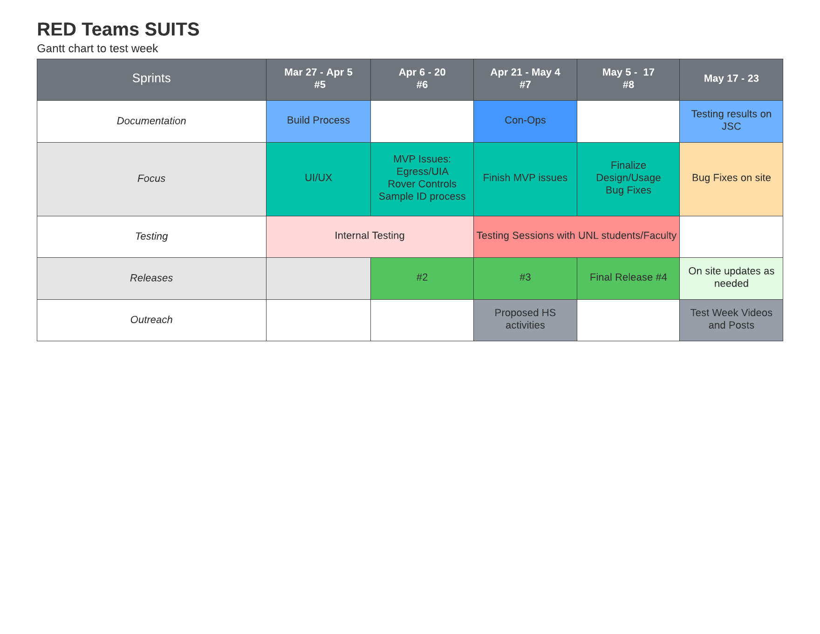
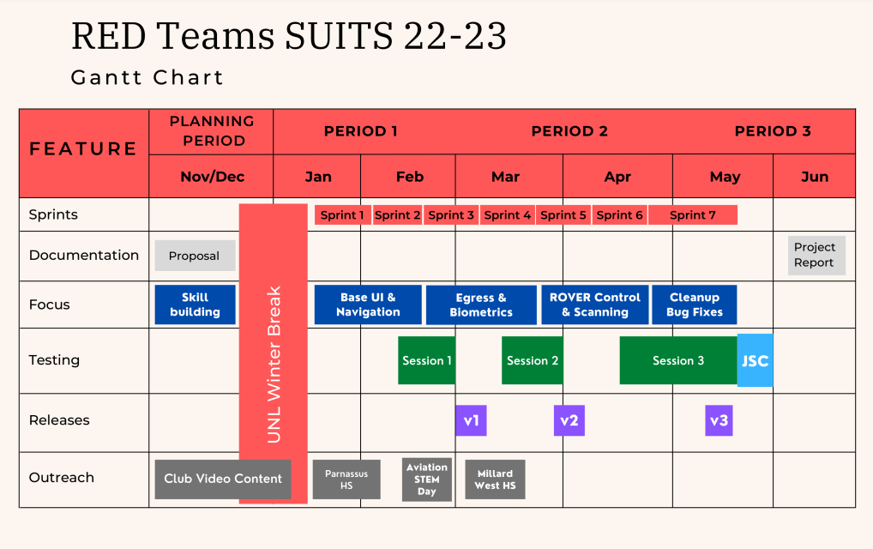

Slide 4



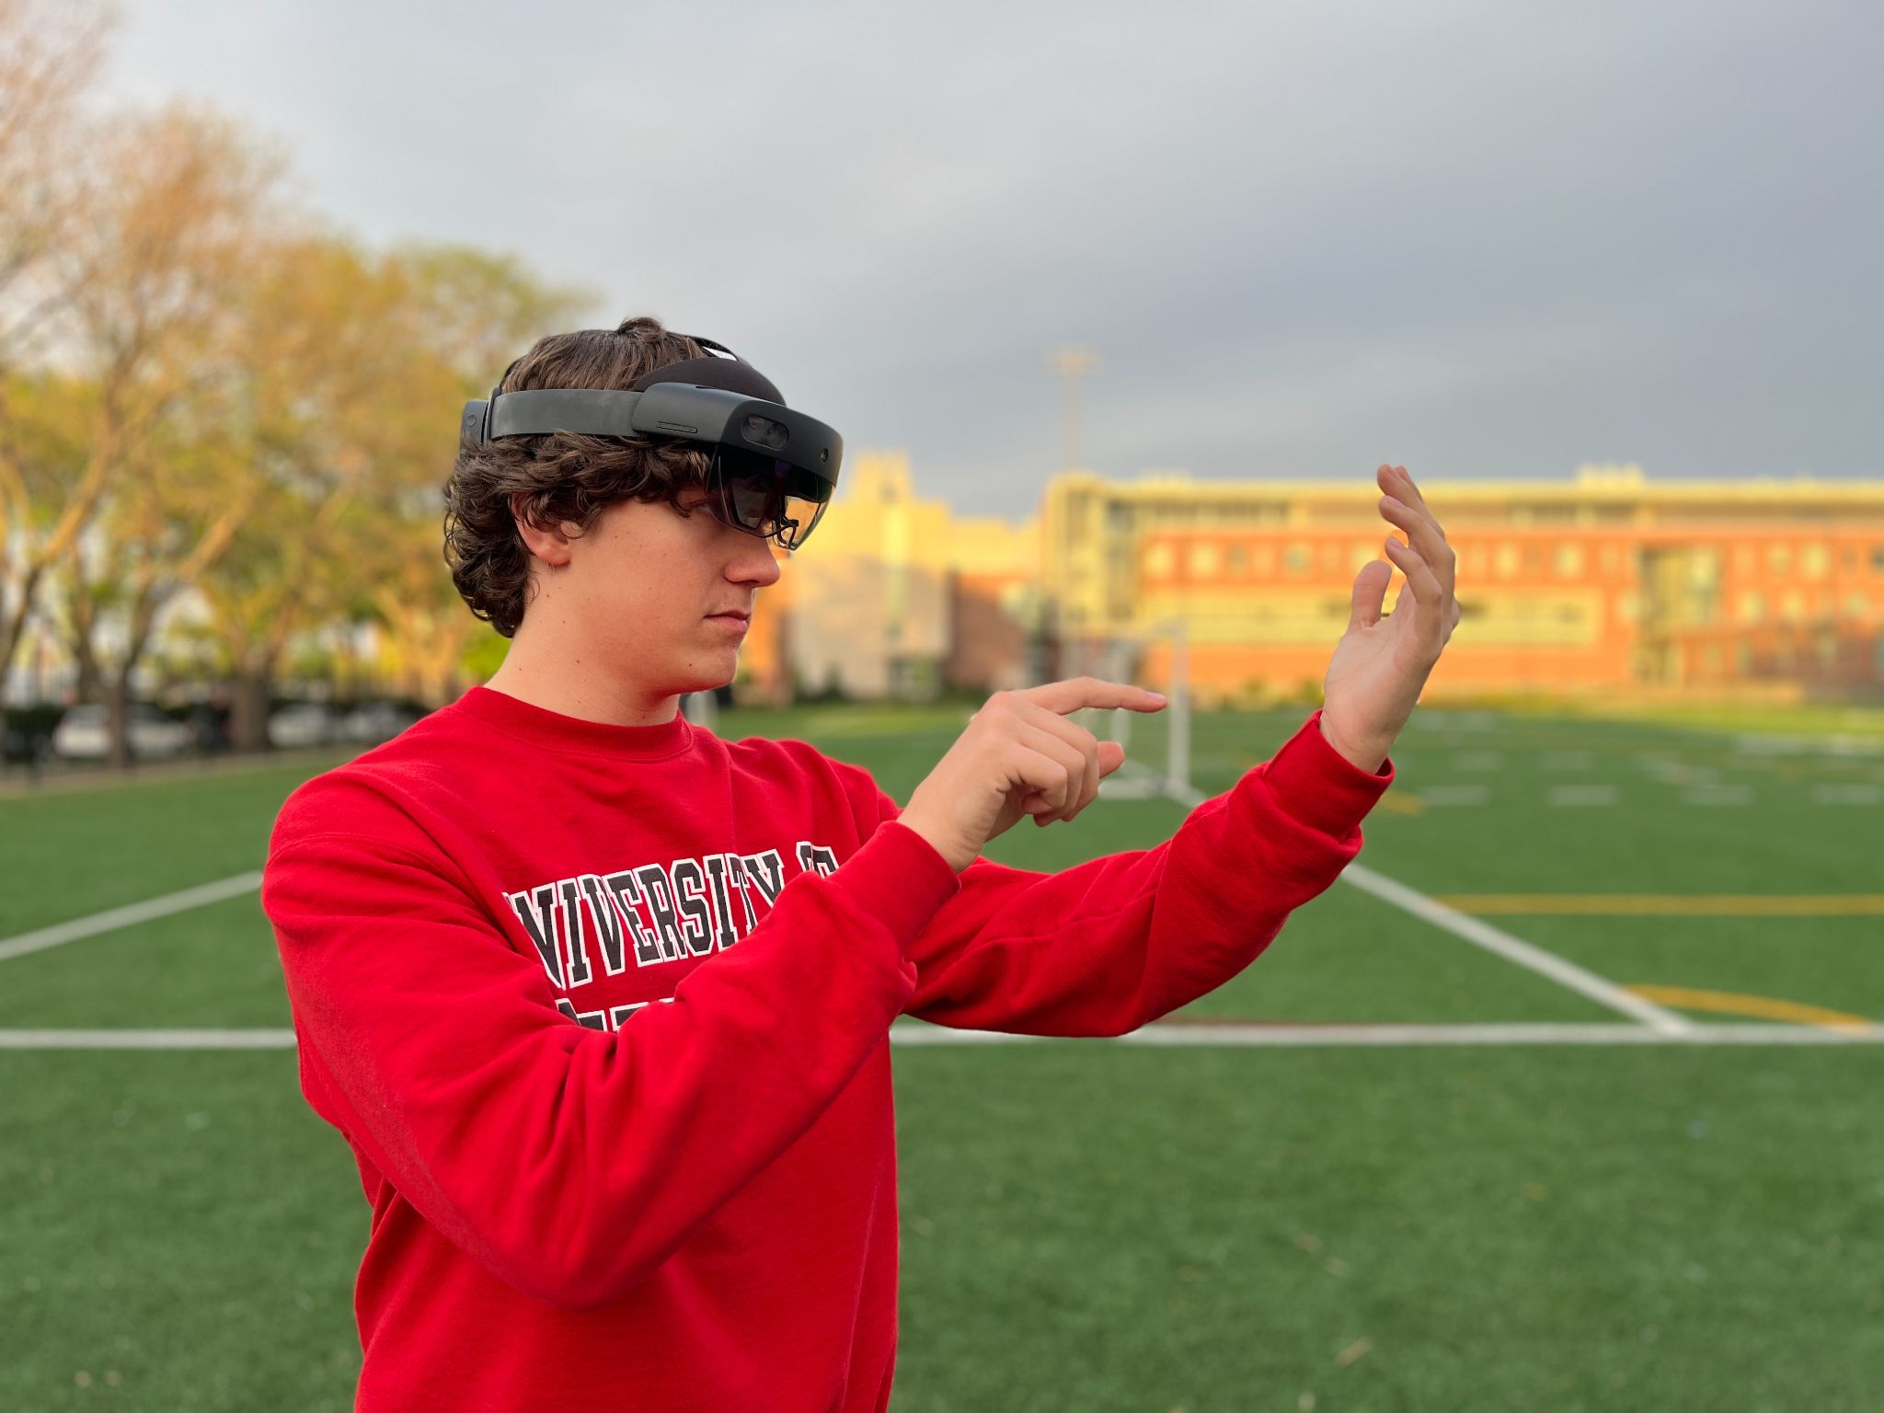
Development
Team first founded this past August as part of RED Teams
Proposal submitted in November, accepted in December, weekly development meetings began in January
Developed in MRTK 3.0
Used ZenHub for GitHub issue management
Notes:
Matthew

Slide 5
MORTI Systems
Simple, Intuitive Design
An always visible HUD for important bioinformatics
User Menus to access and complete mission tasks
Notes:
Matthew
Main idea to help astronauts complete required tasks with an effective UI for important informations and a UX Menu system to assist with EVA Tasks

Slide 6
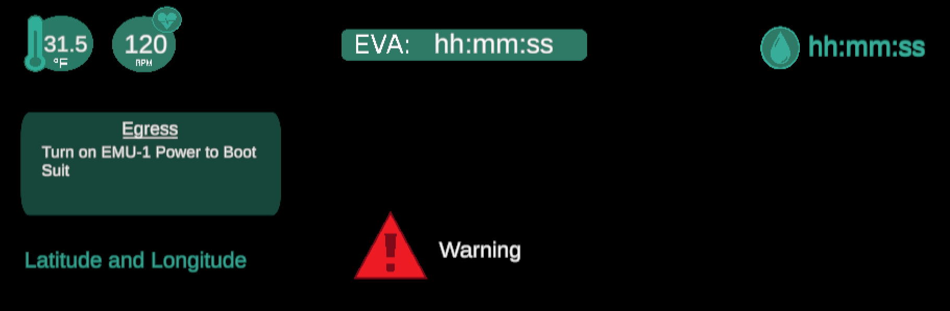
HUD Elements
Simple Clear Design mentality
Placement and development of HUD Elements
Notes:
Payton and Lindsey
Need new photo of final UI

Slide 7
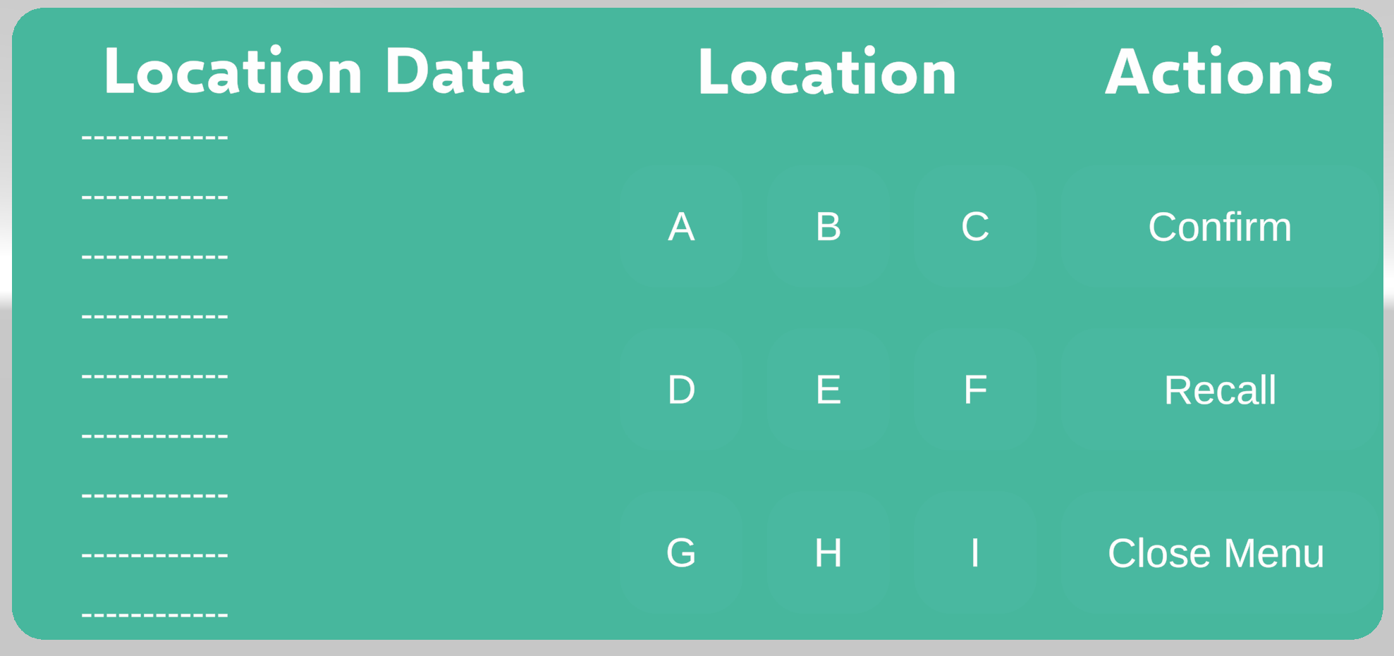
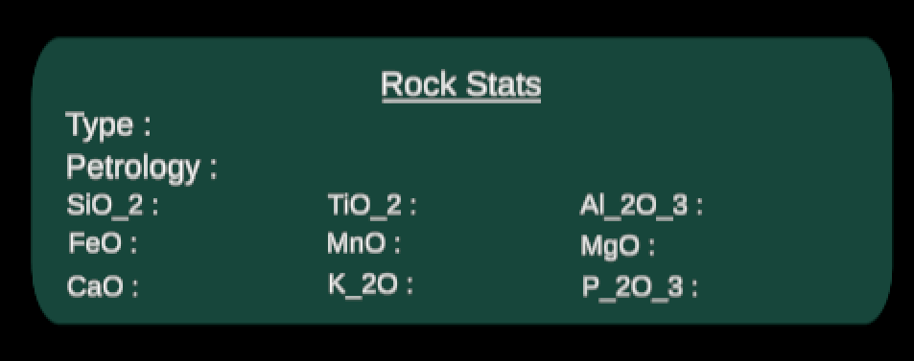
Mission Tasks
Egress/UIA
Sample Collection
Rover Control
Notes:
Charlie talk about menus quickly
Elijah talk about mission tasks

Slide 8
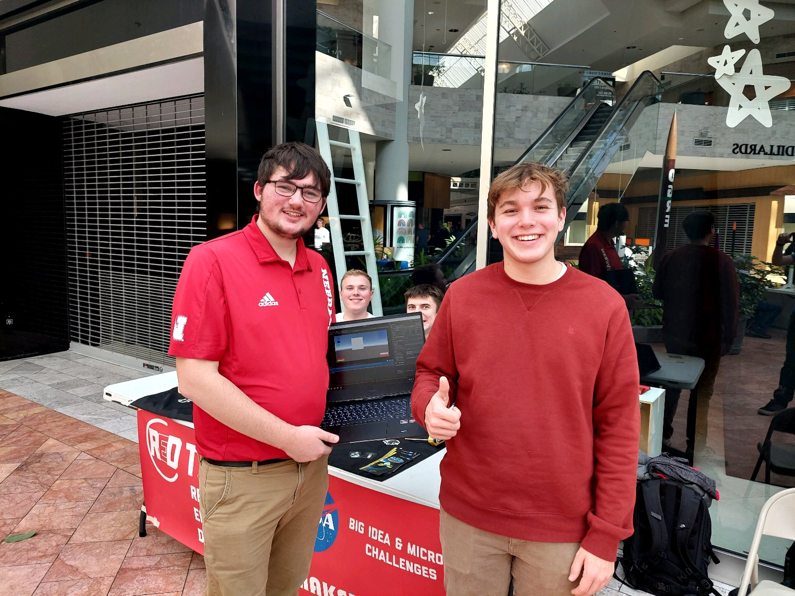
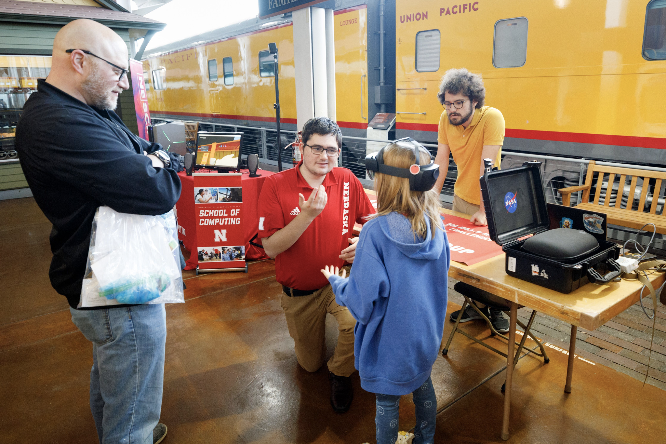
Outreach
NE Science Festival
UNL New Student Enrollment Day
Oakview Mall Aviation STEM Day
Notes:
Matthew
Our Outreach mainly consisted of booths at local STEM Outreach events in the Omaha and Lincoln areas

Slide 9
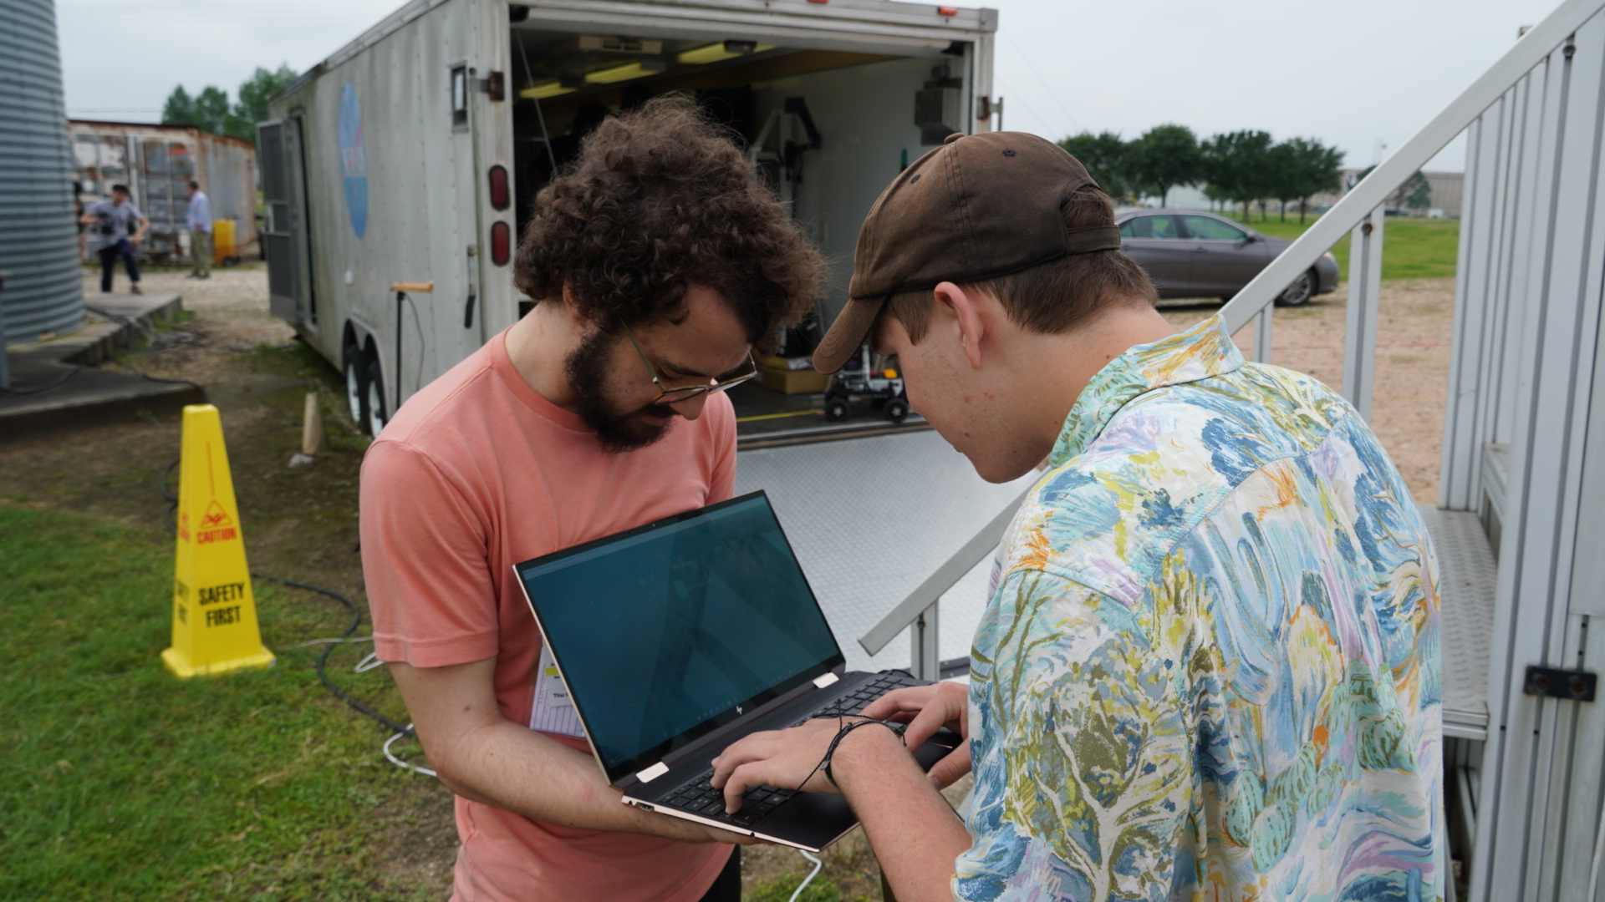
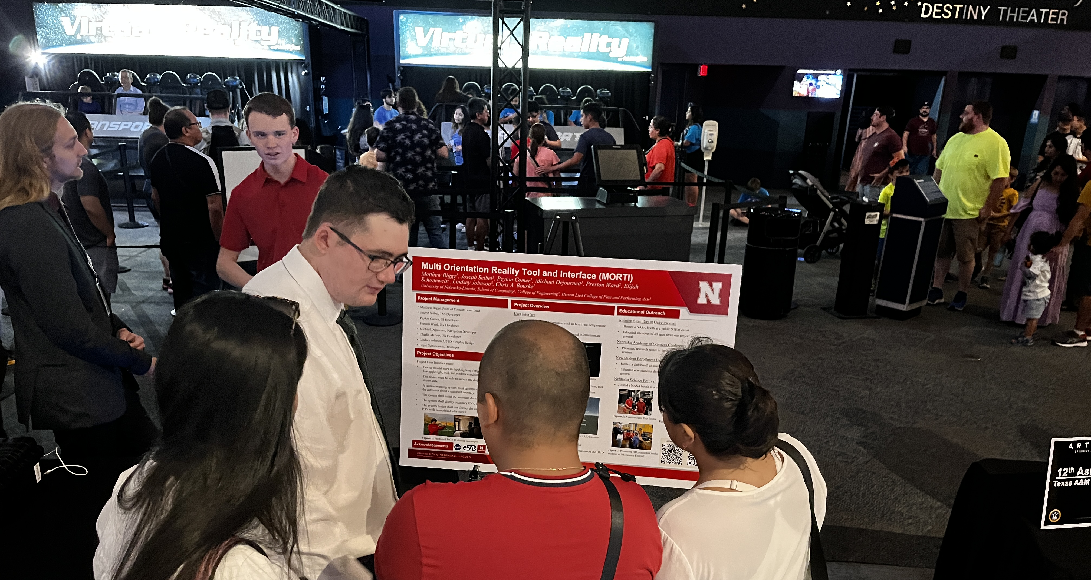
Testing Week
Minor to Major Updates to each system with testing at the Rockyard and final releases of updated TSS
Rockyard testing went well, Rover Control and Sample Collection worked great!
Great time presenting our project and meeting the other teams!
Notes:
Joseph

Slide 10
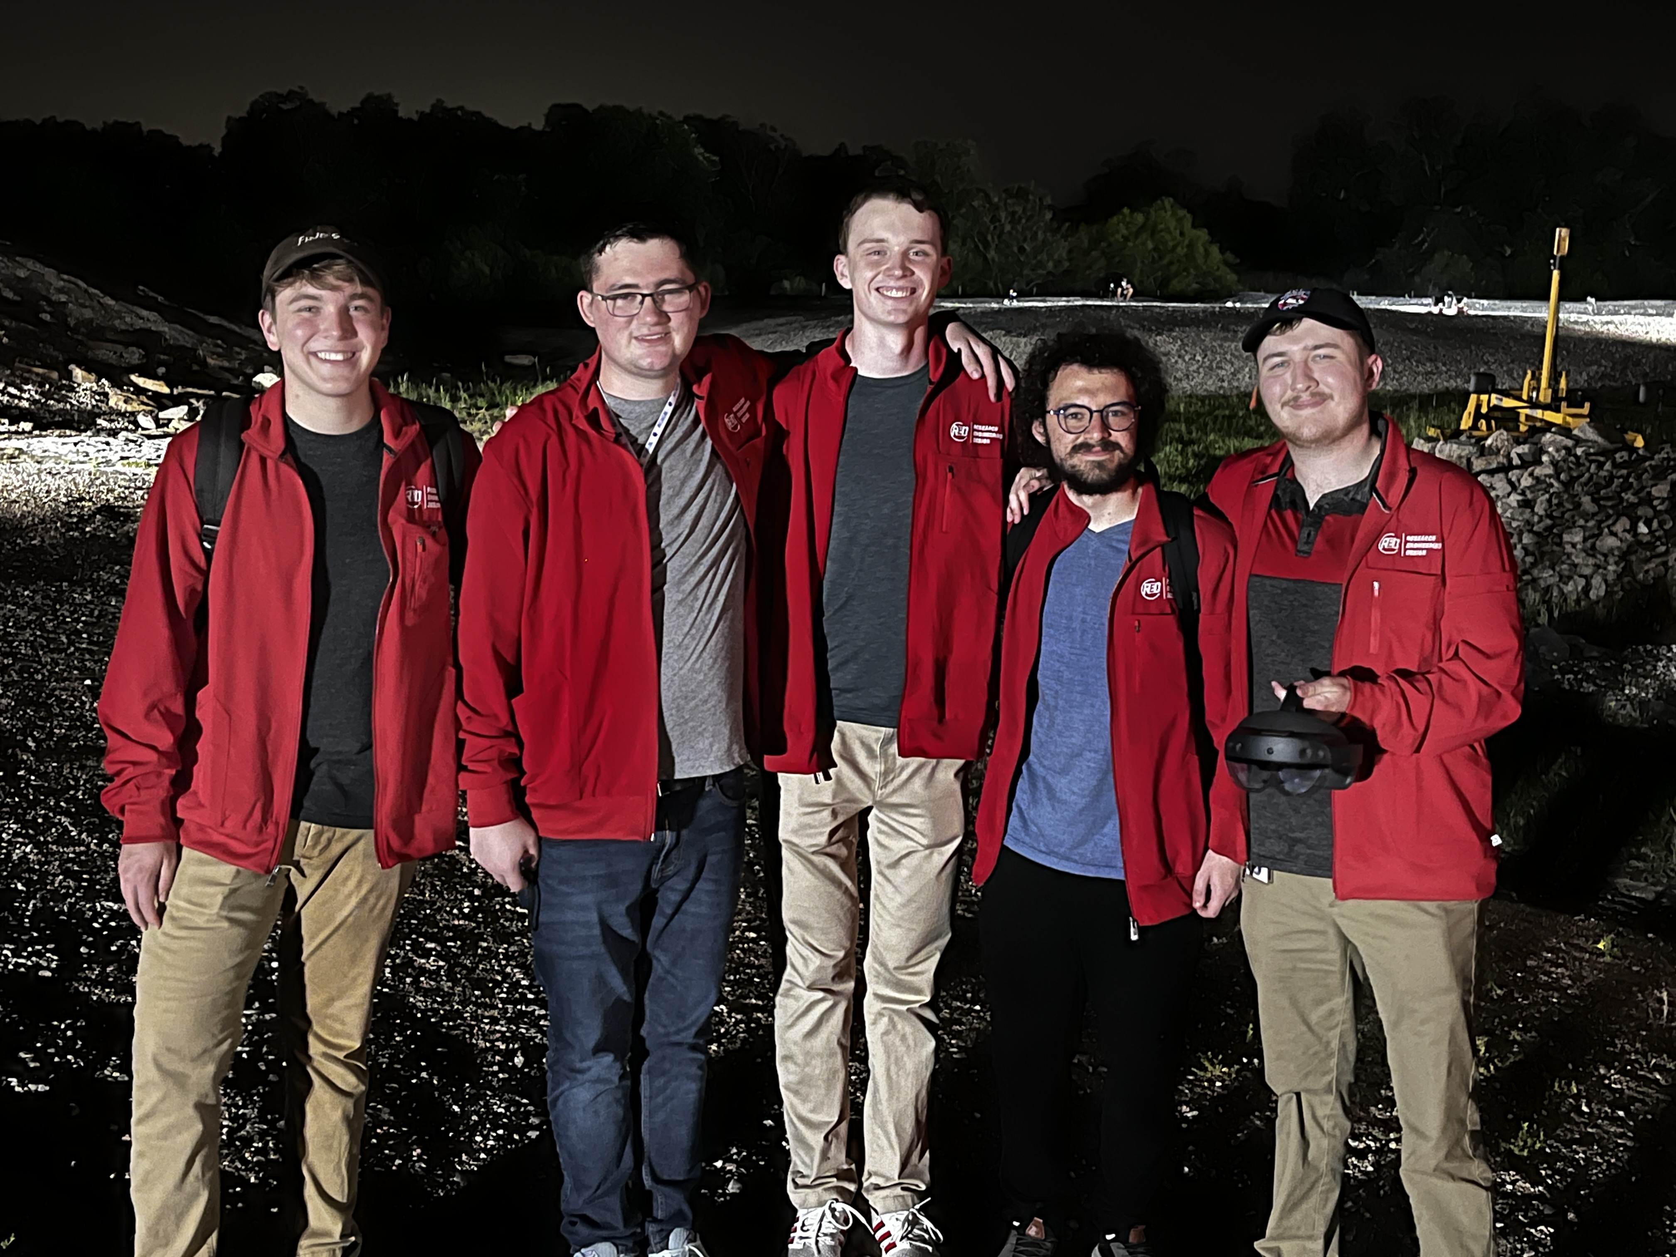
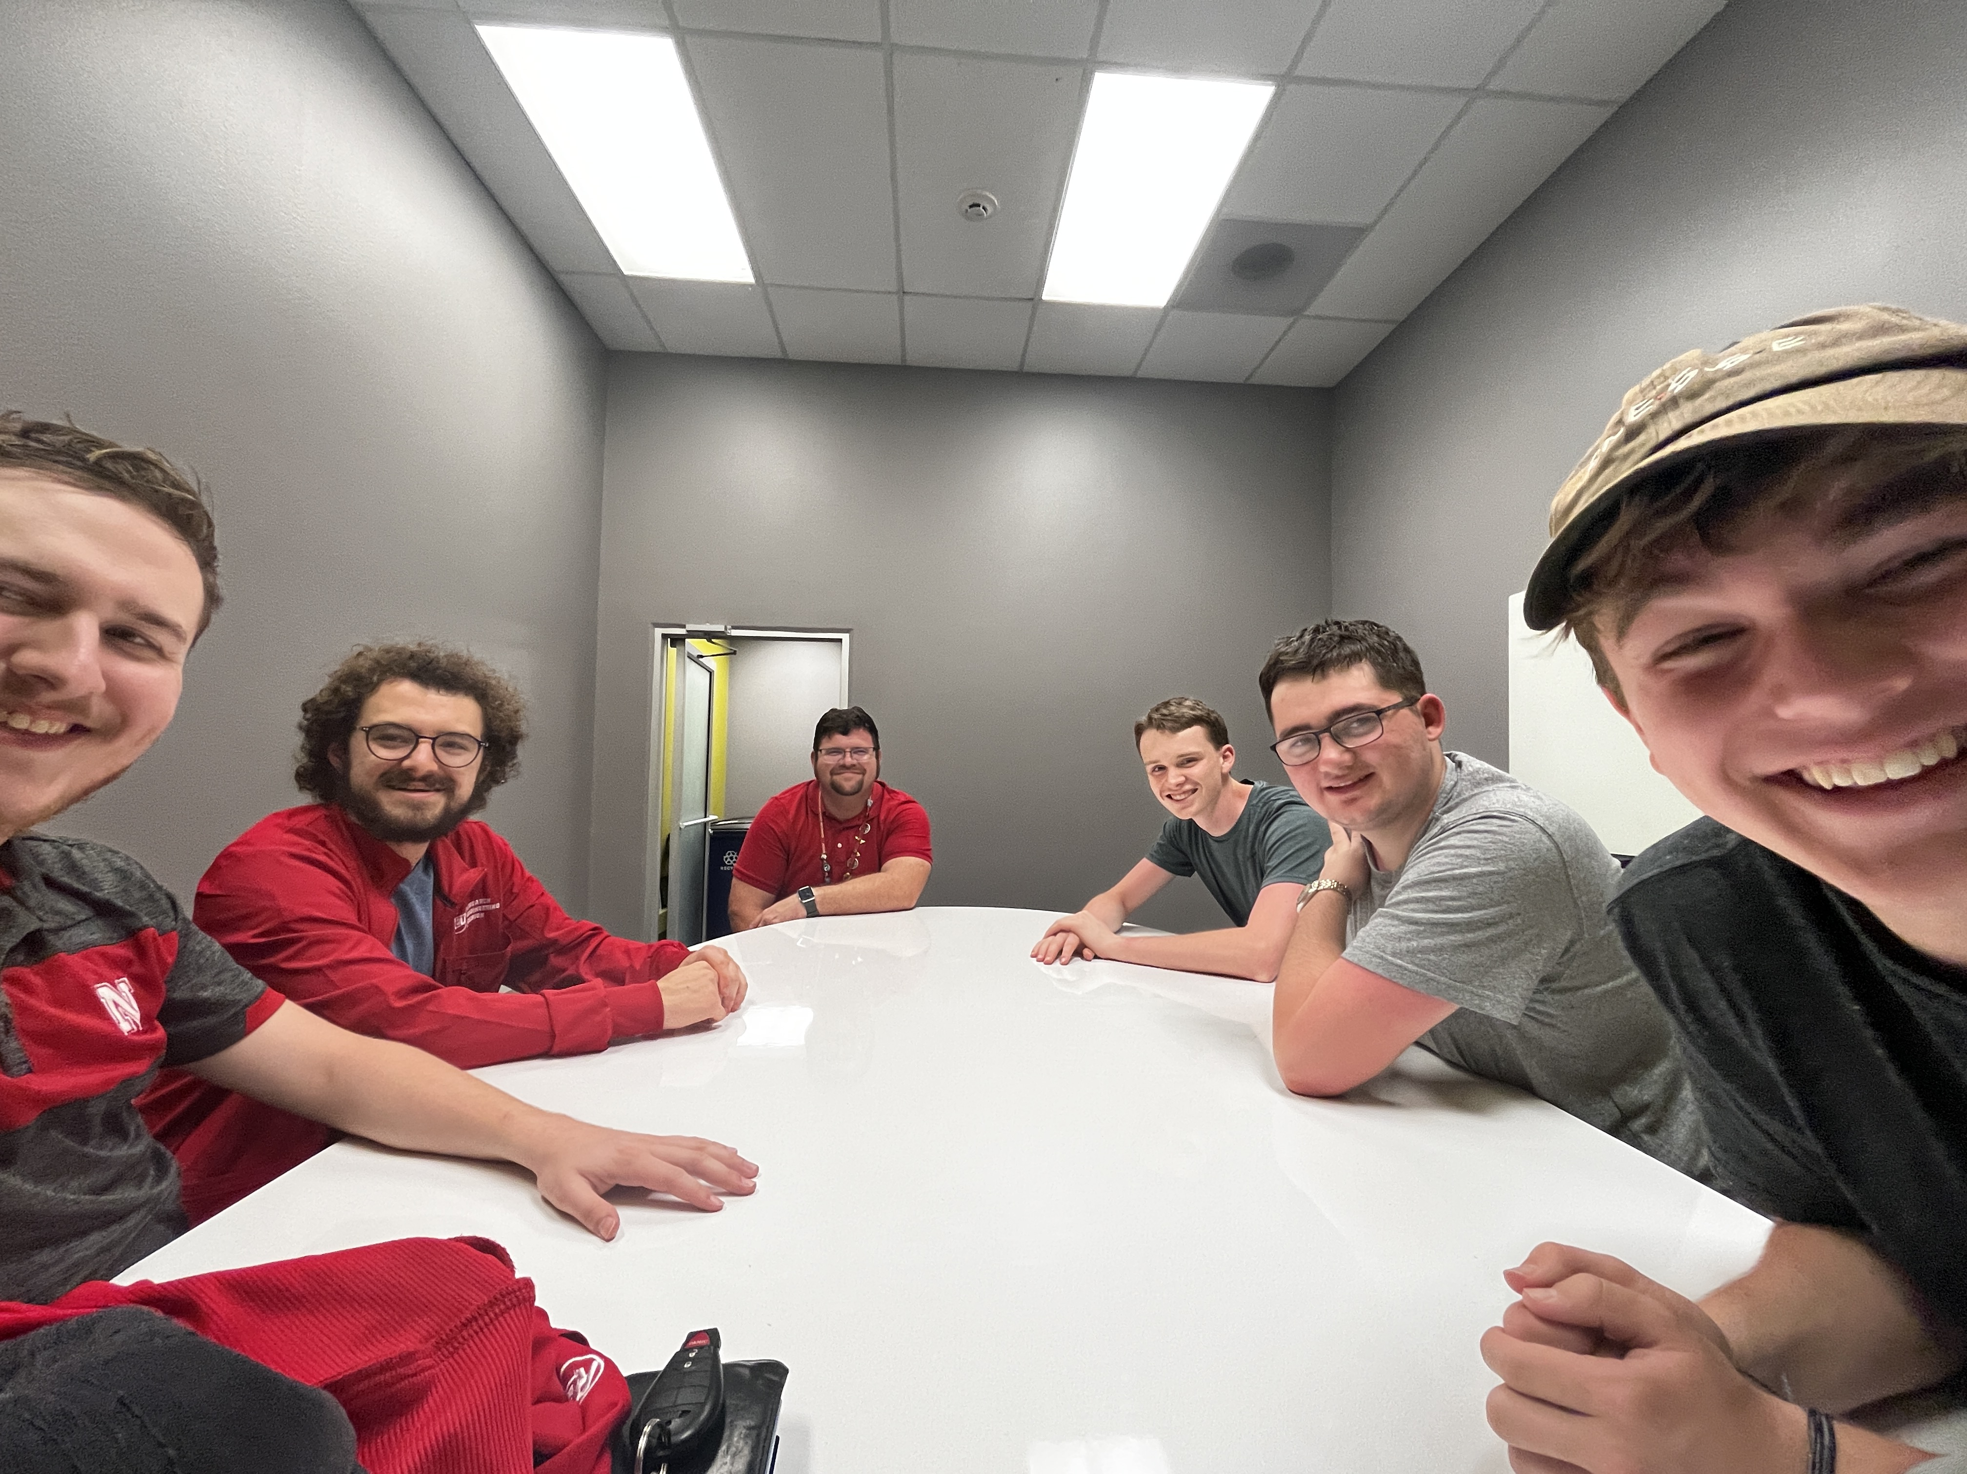
Retrospective
Development earlier, having a mid Feb start data made early adoption of MRTK 3.0 difficult with its lack of documentation
Further promotion to the school for members, contact other University of Nebraska system students(make a joint team with colleagues from UNO)
TSS Dummy data setup on AWS Server for systems not in initial TSS 1.0 for easy testing/dev
Notes:
Matthew

Slide 11
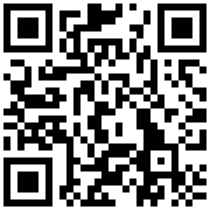
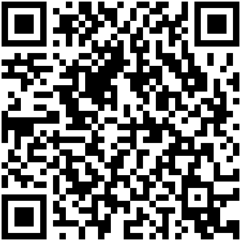
Q&A
Any Questions?
Follow Our Twitter!
GitHub Repository
Notes:
Matthew

Slide 12




Thanks!
Follow Our Twitter!
GitHub Repository
Special thanks for all the support!
Notes:
Matthew

